Slide 1


<Palak Chauhan>
<11-07-2025>

Slide 2

Outline
INDEX | Slide Number
Executive Summary | 3
Introduction | 4
Methodology | 5
Insights Drawn from EDA | 19
Launch Sites Proximities Analysis | 36
Predictive Analysis (classification) | 40
Appendix | 42

Slide 3
Executive Summary
This project aims to predict the success of SpaceX Falcon 9 first-stage landings using historical data, helping estimate potential cost savings from reusability. Data was collected via the SpaceX REST API and web scraping from Wikipedia, then cleaned, wrangled, and enriched for analysis.
Key insights were derived using SQL, and Folium. Classification models (Logistic Regression, SVM, Decision Tree, KNN) were trained and optimized with GridSearchCV. The best-performing model achieved high accuracy in predicting landing outcomes.
Findings:
Success rates improved from 0% (2010) to ~90% (2019)
GEO, SSO, and VLEO orbits had the highest landing success
Heavier payloads (esp. VLEO) correlated with successful landings
Model predictions can aid cost estimation and strategic bidding
This project showcases how data science supports cost-effective, reusable space launch strategies.

Slide 4
Introduction
This project makes predictions about the Falcon 9's successful first stage landing. On its website, SpaceX promotes Falcon 9 rocket launches, which cost 62 million dollars. Other companies charge up to 165 million dollars per, and SpaceX saves a lot of money by reusing the first stage. The cost of a launch may therefore be estimated if we can ascertain if the first stage will land. If a different business want to bid against SpaceX for a rocket launch, they can utilise this information.
⋆｡
🚀
｡°✩
ᯓ★

Slide 5

Section 1

Slide 6
Methodology - Executive Summary
Data collection methodology:
collected using the SpaceX REST API to retrieve detailed JSON records of past Falcon 9 launches and through web scraping Wikipedia launch tables, enabling the creation of a clean, structured dataset for analysis.
Perform data wrangling
Data Cleaning, Feature Extraction, Categorical Encoding and Missing Value Handling
Perform exploratory data analysis (EDA) using visualization and SQL
Perform interactive visual analytics using Folium and Plotly Dash
Perform predictive analysis using classification models

Slide 7
Data Collection
I worked with SpaceX launch data that is gathered from an API, specifically the SpaceX REST API. This API gave us data about launches, including information about the rocket used, payload delivered, launch specifications, landing specifications, and landing outcome in JSON format. I used this data to predict whether SpaceX will attempt to land a rocket or not. It is converted into a flat table using json_normalize and further processed using additional API endpoints to resolve ID references (like rocket or launchpad). The project also involves web scraping launch data from Wikipedia using BeautifulSoup, filtering only Falcon 9 launches, and handling missing values—specifically filling nulls in PayloadMass with the column mean, while leaving nulls in LandingPad for later processing with one-hot encoding.

Slide 8
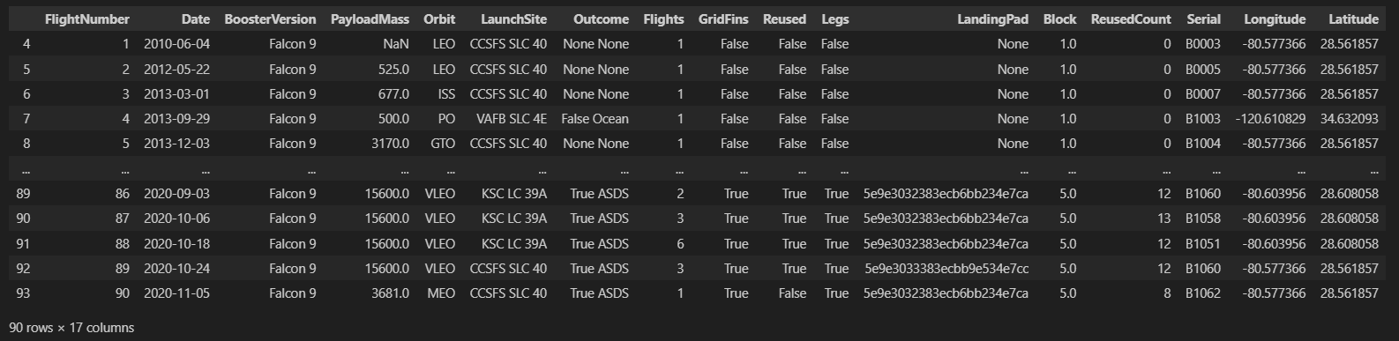
Data Collection – SpaceX API

Slide 9
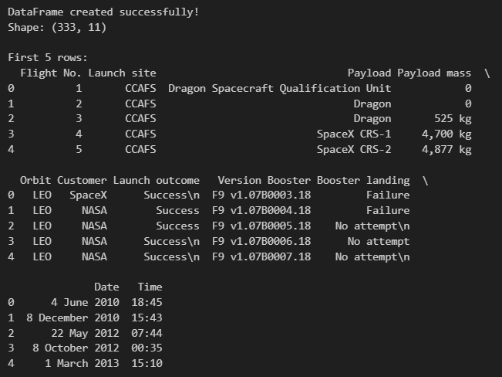
Data Collection - Scraping
Place your flowchart of web scraping here
Objectives:
Web scrap Falcon 9 launch records with `BeautifulSoup`:
Extract a Falcon 9 launch records HTML table from Wikipedia
Parse the table and convert it into a Pandas data frame

Slide 10
Data Wrangling
Key attributes such as Flight Number, Booster Version, Payload Mass, Orbit, Launch Site, and Outcome were reviewed and processed. The Outcome column was transformed into a binary classification variable Y, where 1 represents a successful landing and 0 indicates failure. Attributes like Orbit and LaunchSite were also categorized for analysis.
Key Phrases:
Data Cleaning: Removed irrelevant entries and corrected formatting inconsistencies.
Feature Extraction: Converted complex text outcomes into binary classification (0 = failed, 1 = successful).
Categorical Encoding: Categorized values like Orbit and LaunchSite for model compatibility.
Missing Value Handling: Addressed nulls, where applicable, through imputation or exclusion.

Slide 11
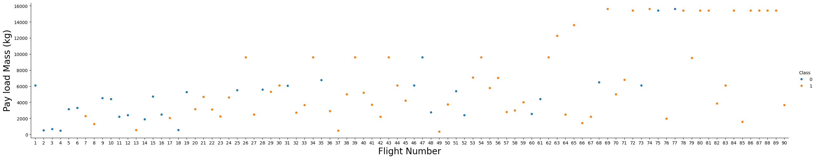
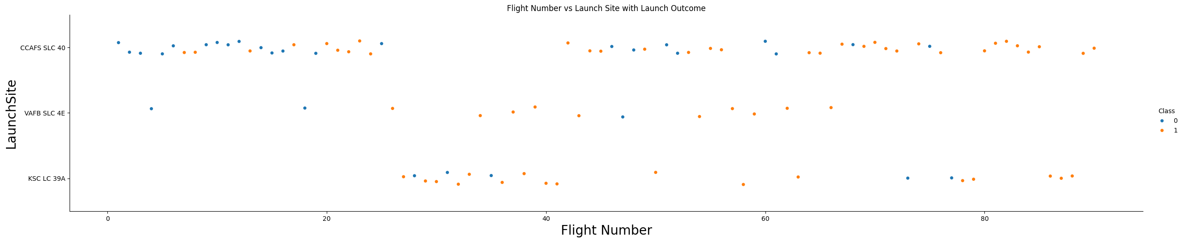
EDA with Data Visualization

Slide 12
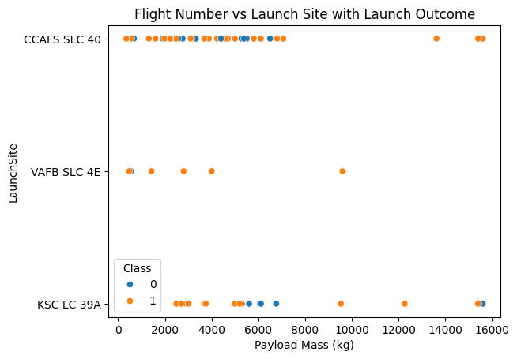
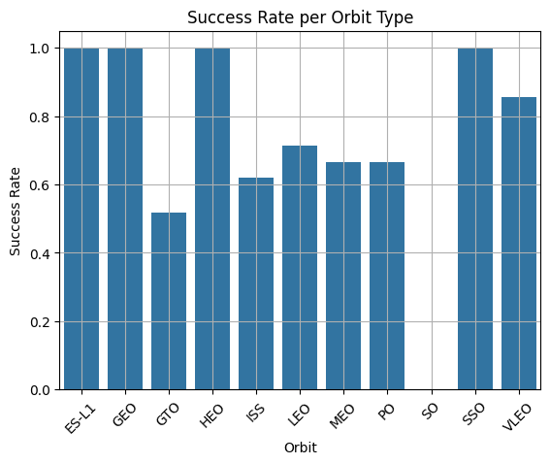
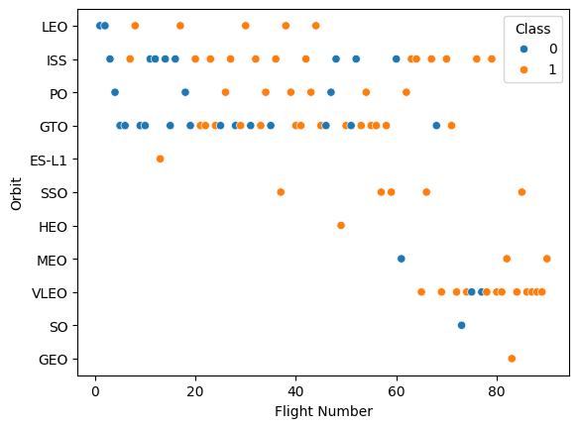
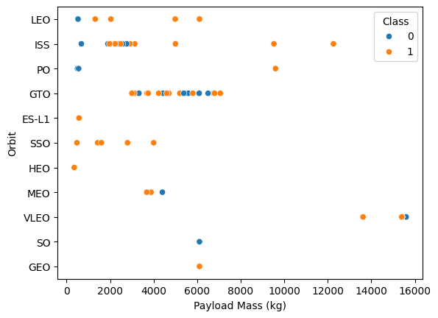
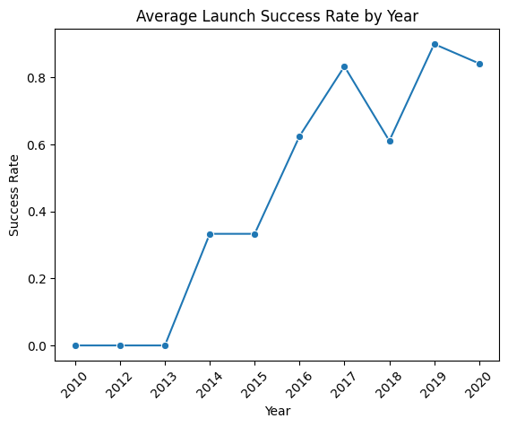
EDA with Data Visualization

Slide 13
EDA with SQL
Loaded Data: Imported data from a SQLite database for exploratory data analysis (EDA).
Viewed Table Structure: Used queries like SELECT * FROM table_name LIMIT n; to preview the contents of tables.
Inspected Table Schema: Queried metadata using .schema or PRAGMA table_info(table_name); to understand table columns and data types.
Aggregated Data: Performed aggregation with queries such as SELECT COUNT(*) FROM table_name; to count rows. Used GROUP BY and aggregate functions (e.g., AVG(), SUM(), MAX(), MIN()) to summarize data.
Filtered Data: Applied WHERE clauses to filter records based on specific conditions.
Joined Tables: Used JOIN statements to combine data from multiple tables based on key relationships.
Sorted Data: Ordered query results using ORDER BY clauses.
Selected Distinct Values: Extracted unique values from columns using SELECT DISTINCT column_name FROM table_name;.
Limited Results: Restricted the number of rows returned with LIMIT.

Slide 14
Build an Interactive Map with Folium
Markers -
Launch Site Markers: Custom markers with popups for each SpaceX launch site. To visually represent each launch site location on the map and provide details when clicked.
Circle Markers -
Proximity Markers (e.g., closest city, highway, etc.): Small colored circle markers added to show the nearest: City, Railroad, Highway, Coastline To mark the proximity of launch sites to critical infrastructure or geographic features. This helps in analyzing site accessibility, safety, and logistical feasibility.
Lines (Polylines) -
Distance Lines: Lines connecting the launch site to the nearest feature (city, highway, railroad, etc.) Used to visualize and measure the actual straight-line distance from the launch site to the respective feature. This supports site evaluation and comparison.
Popups -
Used in markers to display names or distances (e.g., 'Distance to closest highway: 3.2 km'). Enhance interactivity and convey information clearly when users click on map elements.
Visual Analysis: To allow a clear and interactive comparison of how well launch sites are positioned with respect to essential logistics and environmental factors. Distance Evaluation: To support decision-making regarding launch site efficiency, based on proximity to cities, transport lines, and coastlines. Different colors, shapes, and interactive elements make it easier to distinguish between different types of locations and distances.

Slide 15
Predictive Analysis (Classification)
Outlines the steps followed in building, evaluating, improving, and selecting the best-performing classification model to predict SpaceX Falcon 9 landing outcomes.
1. Data Preprocessing
Cleaned and transformed the dataset. Converted categorical features to numerical using one-hot encoding. Normalized feature values for improved model performance.
2. Feature Selection
Selected relevant features such as 'Payload Mass', 'Launch Site', and 'Booster Version Category'. Dropped low-importance or redundant features.

Slide 16
Predictive Analysis (Classification)
3. Model Training
Trained multiple classification models: Logistic Regression, Support Vector Machine (SVM), Decision Tree, and K-Nearest Neighbors (KNN)
4. Model Evaluation
Evaluated models using test accuracy, confusion matrix, and classification report. Performed hyperparameter tuning using GridSearchCV for models like SVM and Decision Tree.
5. Model Improvement
Applied GridSearchCV for hyperparameter optimization. Improved accuracy and generalization by fine-tuning kernel functions, max depth, and neighbor count.

Slide 17
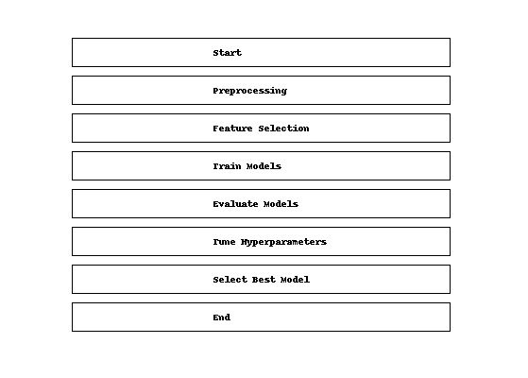
Predictive Analysis (Classification)
6. Model Selection
Compared model performance metrics. Selected the best model based on highest accuracy and balanced performance across metrics.
｡°✩

Slide 18

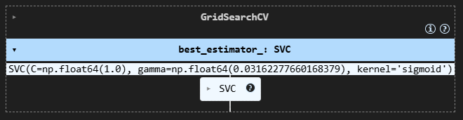
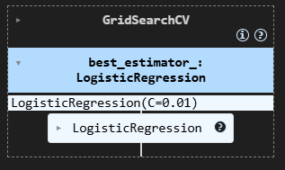
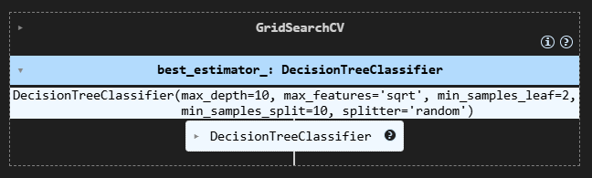
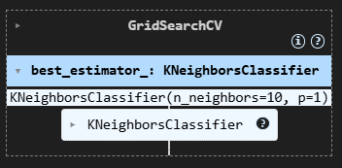
Results

Slide 19

Section 2

Slide 20
Flight Number vs. Launch Site

Slide 21
Payload vs. Launch Site

Slide 22

Success Rate vs. Orbit Type
This Bar chart showcases that Orbits’ ES-L1, GEO, HEO, and SSO have the most success rate

Slide 23

Flight Number vs. Orbit Type
This scatterplot shows SpaceX's mission evolution over time, with early flights concentrated in LEO and ISS orbits, then diversifying to include GTO missions in the middle range, and VLEO missions dominating later flights. The two classes (blue and orange) show distinct patterns across different orbit types and flight numbers, likely representing different mission outcomes or booster configurations.

Slide 24


Payload vs. Orbit Type
This scatterplot reveals that payload mass varies significantly by orbit type, with ISS missions clustering around 2,000-3,000 kg, GTO missions ranging from 3,000-8,000 kg, and VLEO missions carrying the heaviest payloads at 14,000-16,000 kg. Class 1 (orange) dominates most orbit types except for a few Class 0 (blue) missions in LEO, PO, GTO, MEO, and SO orbits.

Slide 25

Launch Success Yearly Trend
This line chart shows SpaceX's launch success rate dramatically improved over time, starting at 0% from 2010-2013, then jumping to about 33% in 2014-2015, reaching a peak of roughly 90% in 2019 before settling around 83% in 2020. The data reveals a clear learning curve with SpaceX achieving consistently high success rates (60-90%) from 2016 onward after several years of early failures.

Slide 26
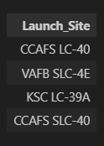
All Launch Site Names
%sql SELECT DISTINCT Launch_Site FROM SPACEXTABLE

Slide 27
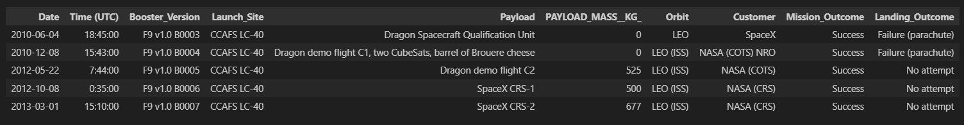
Launch Site Names Begin with 'CCA'
%sql SELECT * FROM SPACEXTABLE WHERE Launch_Site LIKE 'CCA%' LIMIT 5

Slide 28
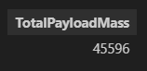
Total Payload Mass
%sql SELECT SUM(PAYLOAD_MASS__KG_) AS TotalPayloadMass FROM SPACEXTABLE WHERE Customer = 'NASA (CRS)'

Slide 29
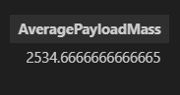
Average Payload Mass by F9 v1.1
%sql select AVG(PAYLOAD_MASS__KG_) AS AveragePayloadMass from SPACEXTABLE where Booster_Version LIKE '%v1.1%'

Slide 30

First Successful Ground Landing Date
%sql SELECT MIN(Date) AS FirstDroneShipLanding FROM SPACEXTABLE WHERE Landing_Outcome = 'Success (ground pad)'

Slide 31
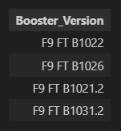
Successful Drone Ship Landing with Payload between 4000 and 6000
%sql SELECT Booster_Version FROM SPACEXTABLE WHERE Landing_Outcome = 'Success (drone ship)' AND PAYLOAD_MASS__KG_ BETWEEN 4001 AND 5999

Slide 32
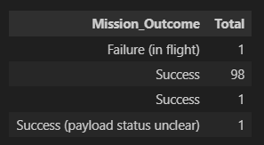
Total Number of Successful and Failure Mission Outcomes
%sql SELECT Mission_Outcome, COUNT(*) AS Total FROM SPACEXTABLE GROUP BY Mission_Outcome

Slide 33
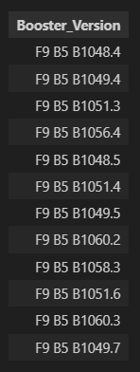
Boosters Carried Maximum Payload
%sql SELECT Booster_Version FROM SPACEXTABLE WHERE PAYLOAD_MASS__KG_ = ( SELECT MAX(PAYLOAD_MASS__KG_) FROM SPACEXTABLE )

Slide 34
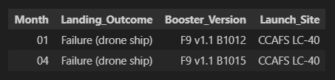
2015 Launch Records
%sql SELECT substr(Date, 6, 2) AS Month, Landing_Outcome,Booster_Version, Launch_Site FROM SPACEXTABLE WHERE substr(Date, 0, 5) = '2015' AND Landing_Outcome LIKE '%Failure (drone ship)%';

Slide 35
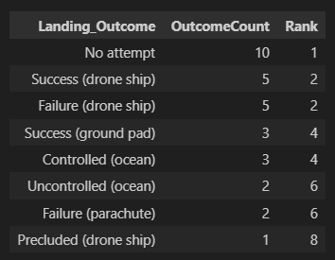
Rank Landing Outcomes Between 2010-06-04 and 2017-03-20
%sql SELECT Landing_Outcome, COUNT(*) AS OutcomeCount, RANK() OVER (ORDER BY COUNT(*) DESC) AS Rank FROM SPACEXTABLE WHERE Date BETWEEN '2010-06-04' AND '2017-03-20' GROUP BY Landing_Outcome ORDER BY OutcomeCount DESC

Slide 36

Section 3

Slide 37
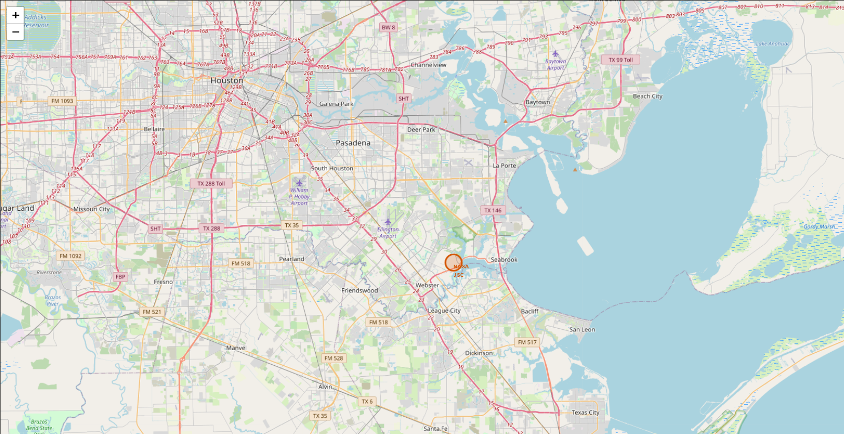
< NASA Johnson Space Center at Houston, Texas >

Slide 38
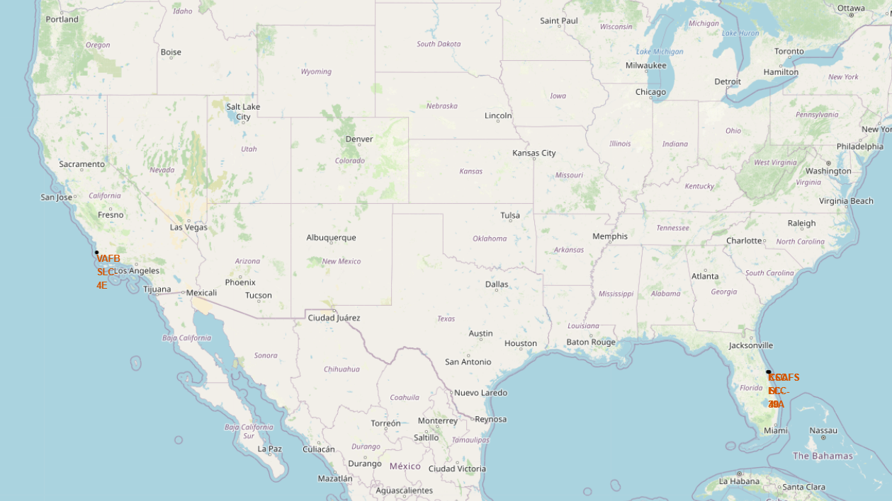
<All Launch sites>

Slide 39
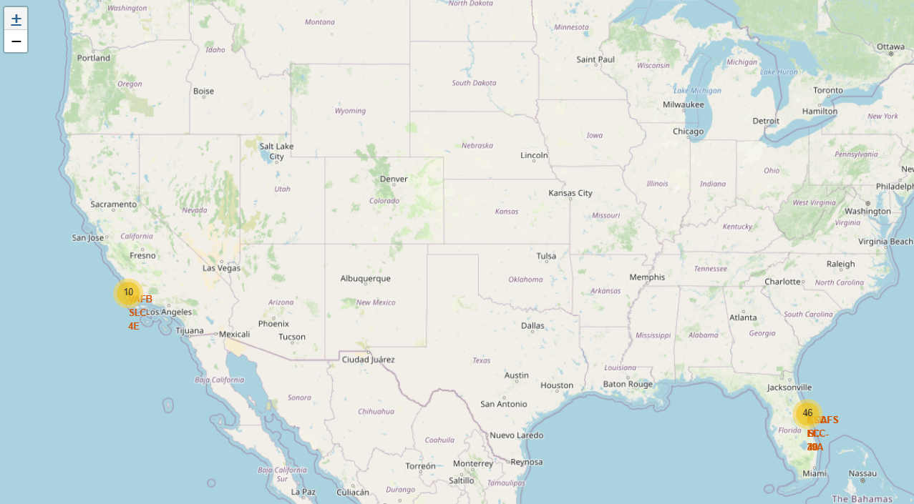
<Successful and Failed Launches>

Slide 40

Section 5

Slide 41
Confusion Matrix

Slide 42
Appendix
Include any relevant assets like Python code snippets, SQL queries, charts, Notebook outputs, or data sets that you may have created during this project
Datasets used:
i. SpaceX API : https://api.spacexdata.com/v4/launches/past
ii. JSON: https://cf-courses-data.s3.us.cloud-object-storage.appdomain.cloud/IBM-DS0321EN-SkillsNetwork/datasets/API_call_spacex_api.json
iii. Snapshot of the List of Falcon 9 and Falcon Heavy launches Wikipage: https://en.wikipedia.org/w/index.php?title=List_of_Falcon_9_and_Falcon_Heavy_launches&oldid=1027686922
iv. spacex_launch_geo.csv
v. dataset_part_1.csv
vi. dataset_part_2 (1).csv
vii. dataset_part_3.csv

Slide 43


